Slide 1

TEAM FAIR AND BALANCED
Devan Visvalingam, Aneesh Sandhir

Slide 2
Exploratory Text Analysis of Youtube News Channel Comments
Devan Visvalingam, Aneesh Sandhir

Slide 3
Background
Curious about general patterns in Youtube comment sections from differing News sources
Didn’t have a set objective or hypothesized recommendation from analysis - purely exploratory
Wanted to pick 4 news sources that differed in their userbases:
Used the Media Bias/Fact Check index to select four news sources differing in their political skews

Slide 4
Choosing our News Sources
Fox News ~ Right bias
American politics, conservative
CNN ~ Left bias
American politics, liberal
BBC ~ Left-center bias (center)
International news, moderate
Breitbart News ~ Conspiracy-pseudoscience
American politics, far right/conspiracy theory

Slide 5
Collecting our Data - Web Crawler that Accesses Youtube’s Data API
Use Youtube’s search algorithm to find a channel or playlist
Request all the comments on each video in batches of 100
Parse the API response for each comment and append all comments from all designated number of videos (n=20) and append to One text file
This single text file for each channel is what is later used in our pre-processing

Slide 6
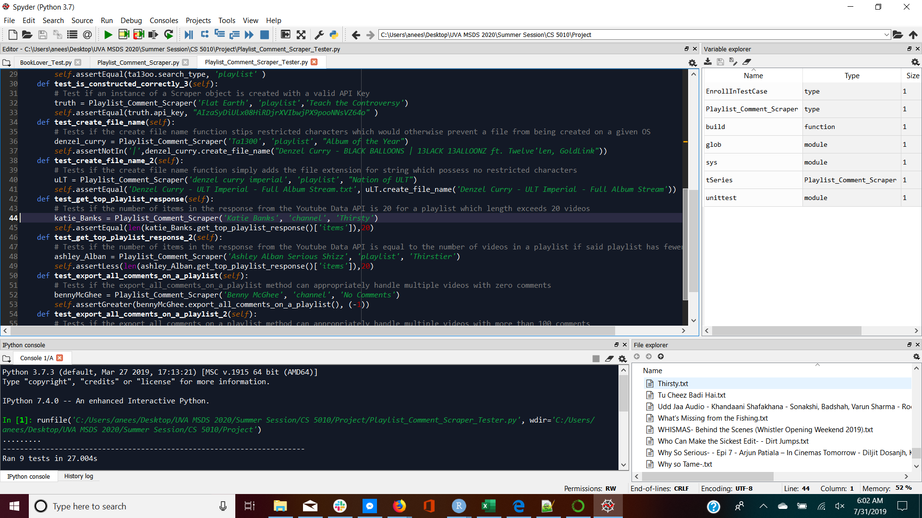
Testing Our Comment Scraper Object
Nine test methods
Positively and negatively tested manipulated attributes
Tested use cases at the boundaries
Tested retrieval via channel and playlist

Slide 7
Pre-processing: Obtaining Desired Data Structure
Our crawler gave us one .txt file per channel
In our case, we chose 4 youtube channels = 4 .txt files

Slide 8
Pre-processing: Obtaining Desired Data Structure
We want these text files to each be their own observation in a pandas dataframe
The level of observation is the text corpus - in this case, it is the total comments per channel (of n= 20 videos)

Slide 9
Pre-processing: Obtaining Desired Data Structure
4 .txt files → a dictionary → pandas dataframe (2 columns)

Slide 10
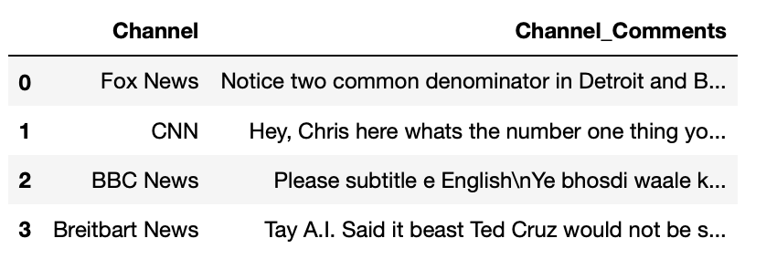
Pandas Dataframe (query 1)
Notice, html code in strings needs to be cleaned (i.e. ‘\n’)

Slide 11
Pre-Processing: Cleaning
Now data is in highly manipulative format
For purpose of first part of text analysis, needed to remove
1) punctuation
2) HTML code bits
3) stop words
4) make all words lowercase

Slide 12
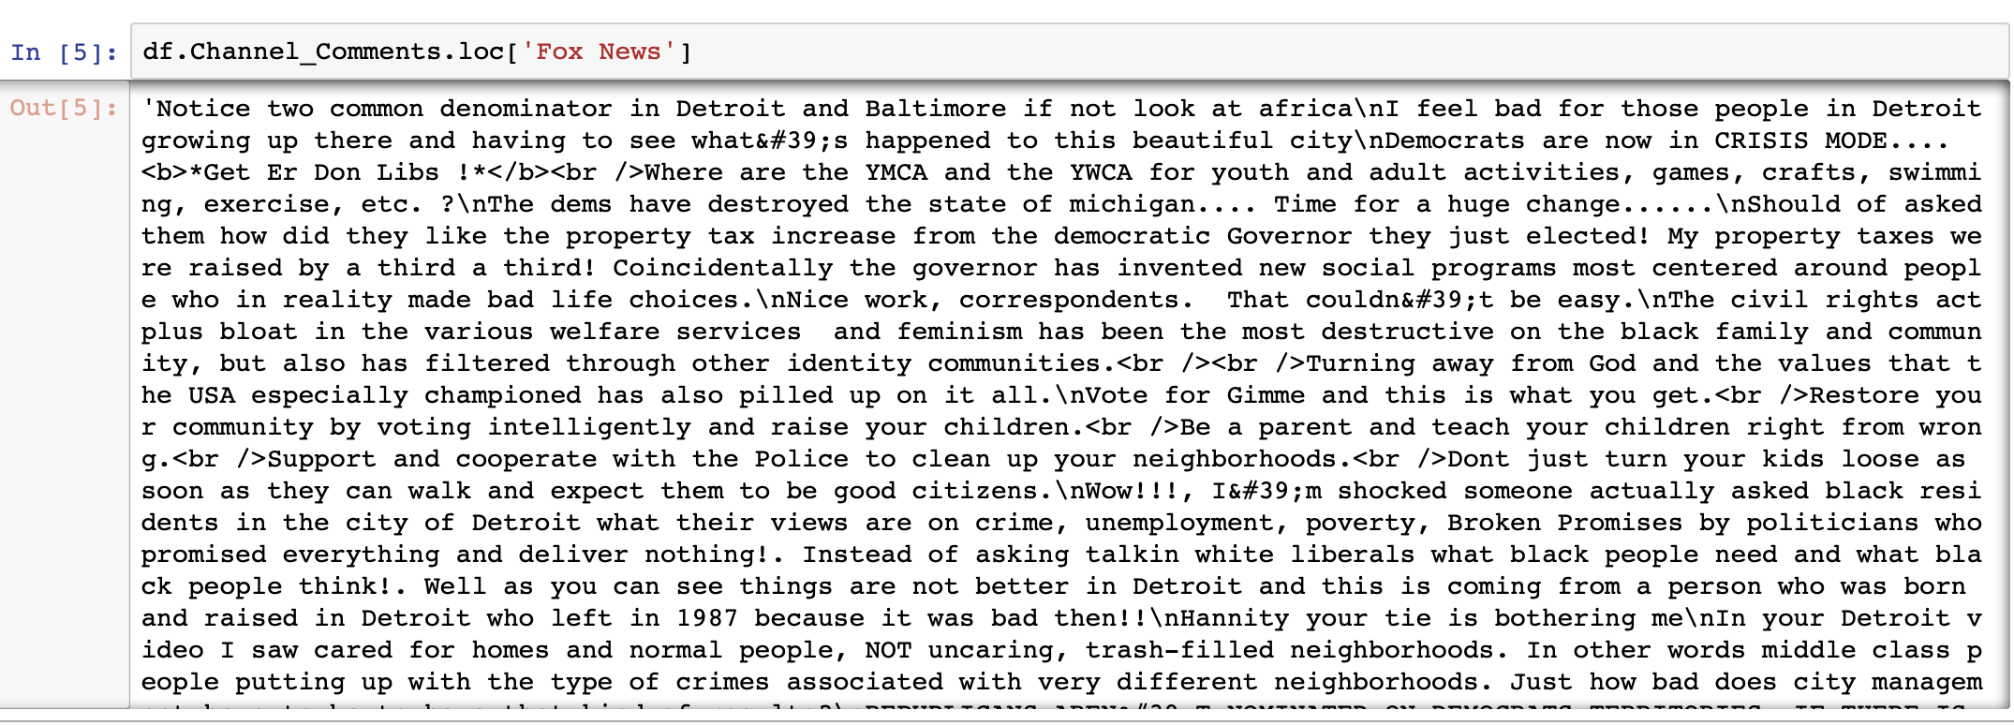
Before:

Slide 13
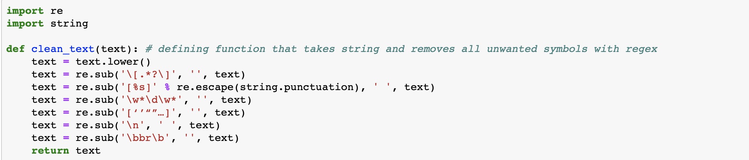
Removing punctuation/html code bits

Slide 14
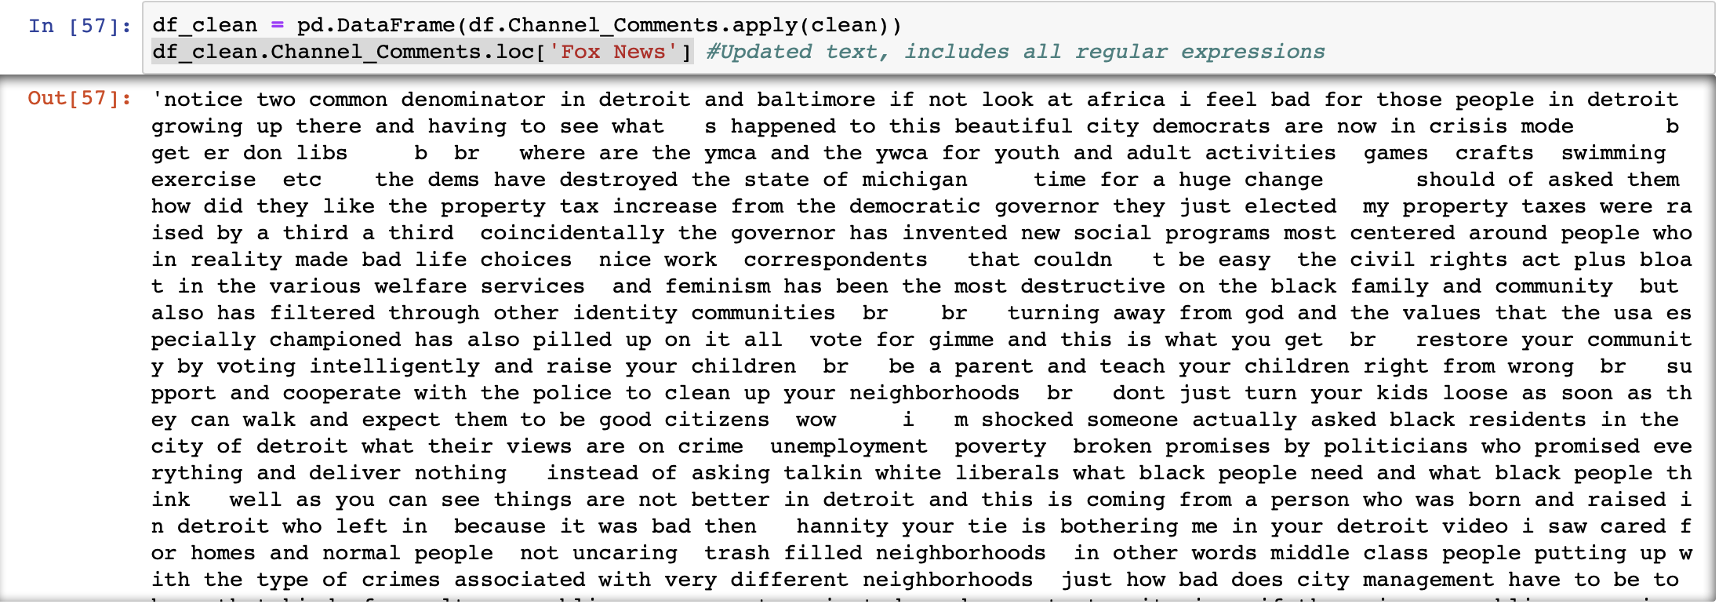
After:

Slide 15
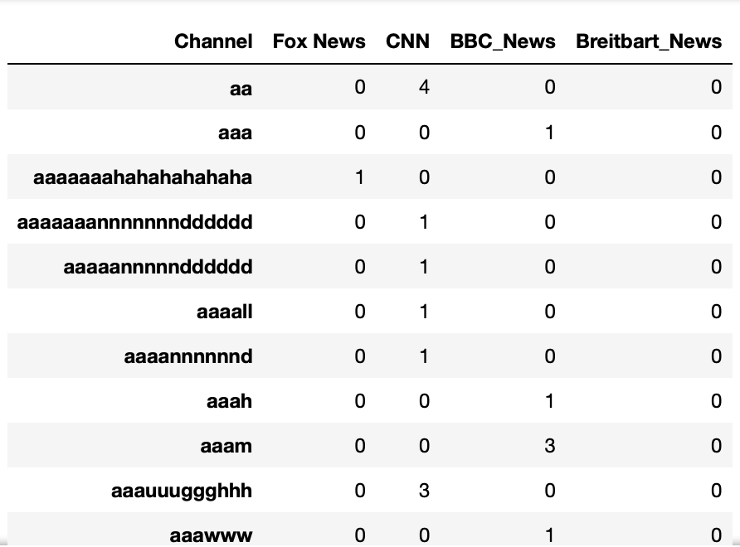
Document Term Matrix (query 2)
Iterated through all words
Basically a table of counts of each unique word
Got rid of Stop Words in this step
Used SKlearn’s CountVectorizer function

Slide 16
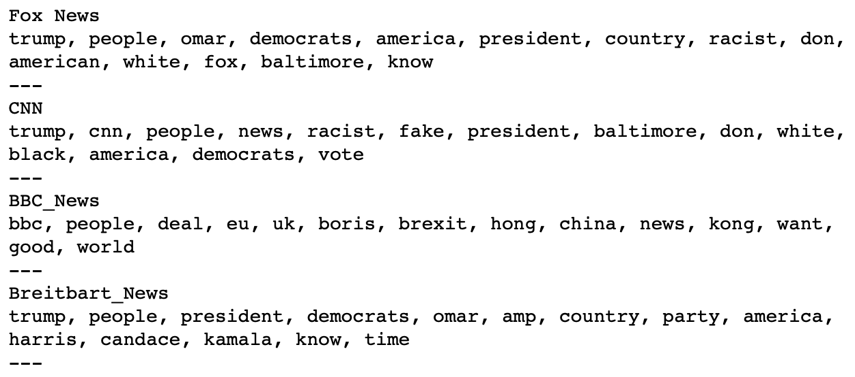
Counting Top Words by News Channel (query 3)

Slide 17
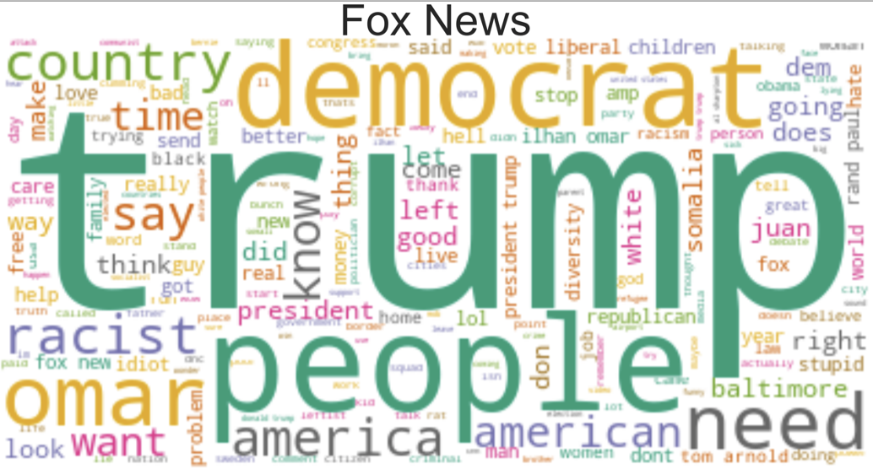
Most Common Words by News Channel

Slide 18
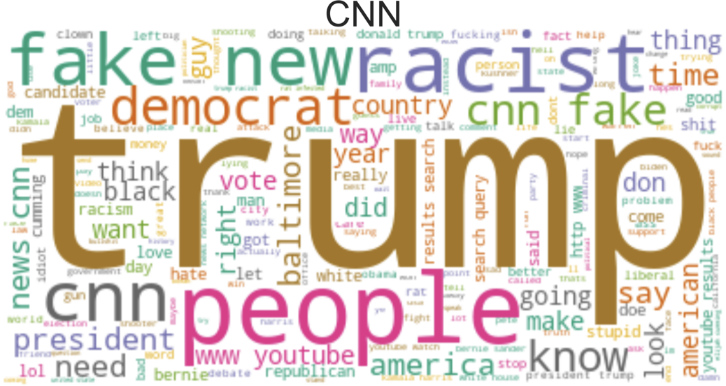
Most Common Words by Media Outlet

Slide 19
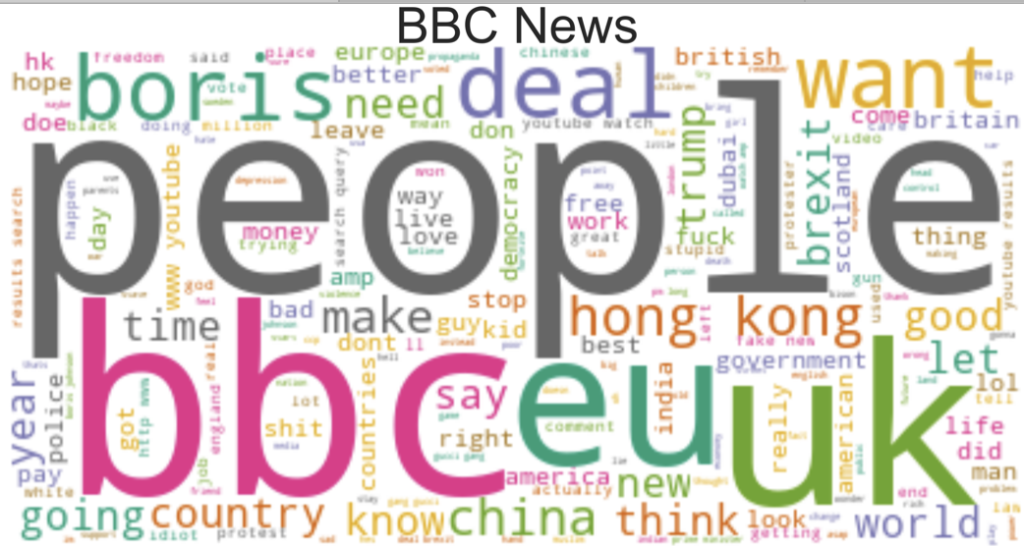
Most Common Words by Media Outlet

Slide 20
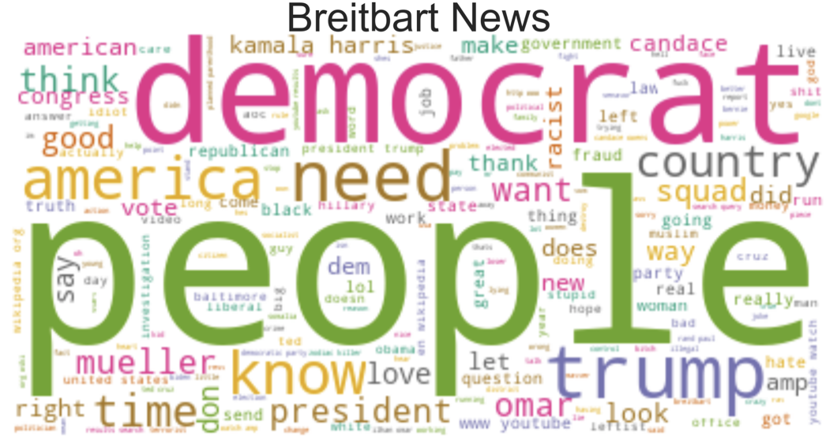
Most Common Words by Media Outlet

Slide 21
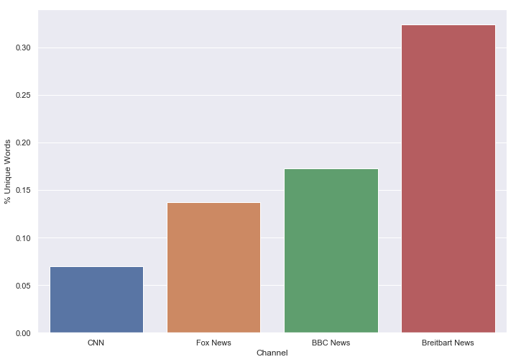
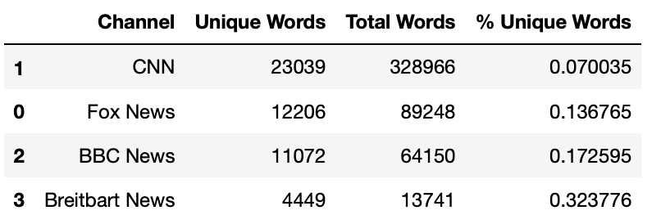
Unique Word County by News Channel (query 4)

Slide 22
Sentiment Analysis
Used package TextBlob
Measured:
1) Polarity: how negative to positive a string is
2) Subjectivity: How factual to opinion-based a string is

Slide 23
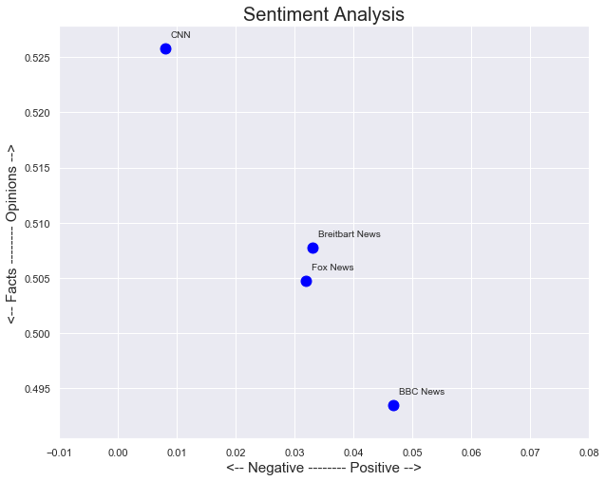
Sentiment Analysis (query 5)

Slide 24
Conclusions
Take into account context of time...

Slide 25
CNN & Democratic Primaries
CNN covers DNC heavily
More traffic channel + more heated debate
→ Negative sentiment ‘polarity’ rating
→ Higher rating on ‘subjectivity’ rating ~ more debate == more opinionated rather than factual comment content
BBC covers more international news, not affected by these American current events

Slide 26
Fox & Breitbart
Age of trump, possibly explains higher sentiment in their comment sections
Happier comments → Less Debate → Less ‘subjective’ or argumentive comments (only conjecture)

Slide 27
BBC
From the sentiment plot:
1) BBC comment sections are highly factual
2) Less ‘sensational’
3) Have the net highest polarity ~ the comment sections are more positive

Slide 28
Further Development of the Youtube API Scraper
Add functionality to the comment scraper such that it can retrieve replies to comments as well as the metadata of both
Record metadata associated with each of the comments and replies and format the output accordingly (export a .json instead of .txt)
Allow the user to specify a window to retrieve all the comments on all the videos uploaded between the specified times. (may require credentials with higher quota limits)

Slide 29
Any Youtube Channels of Interest? (User Interaction)

